Slide 1
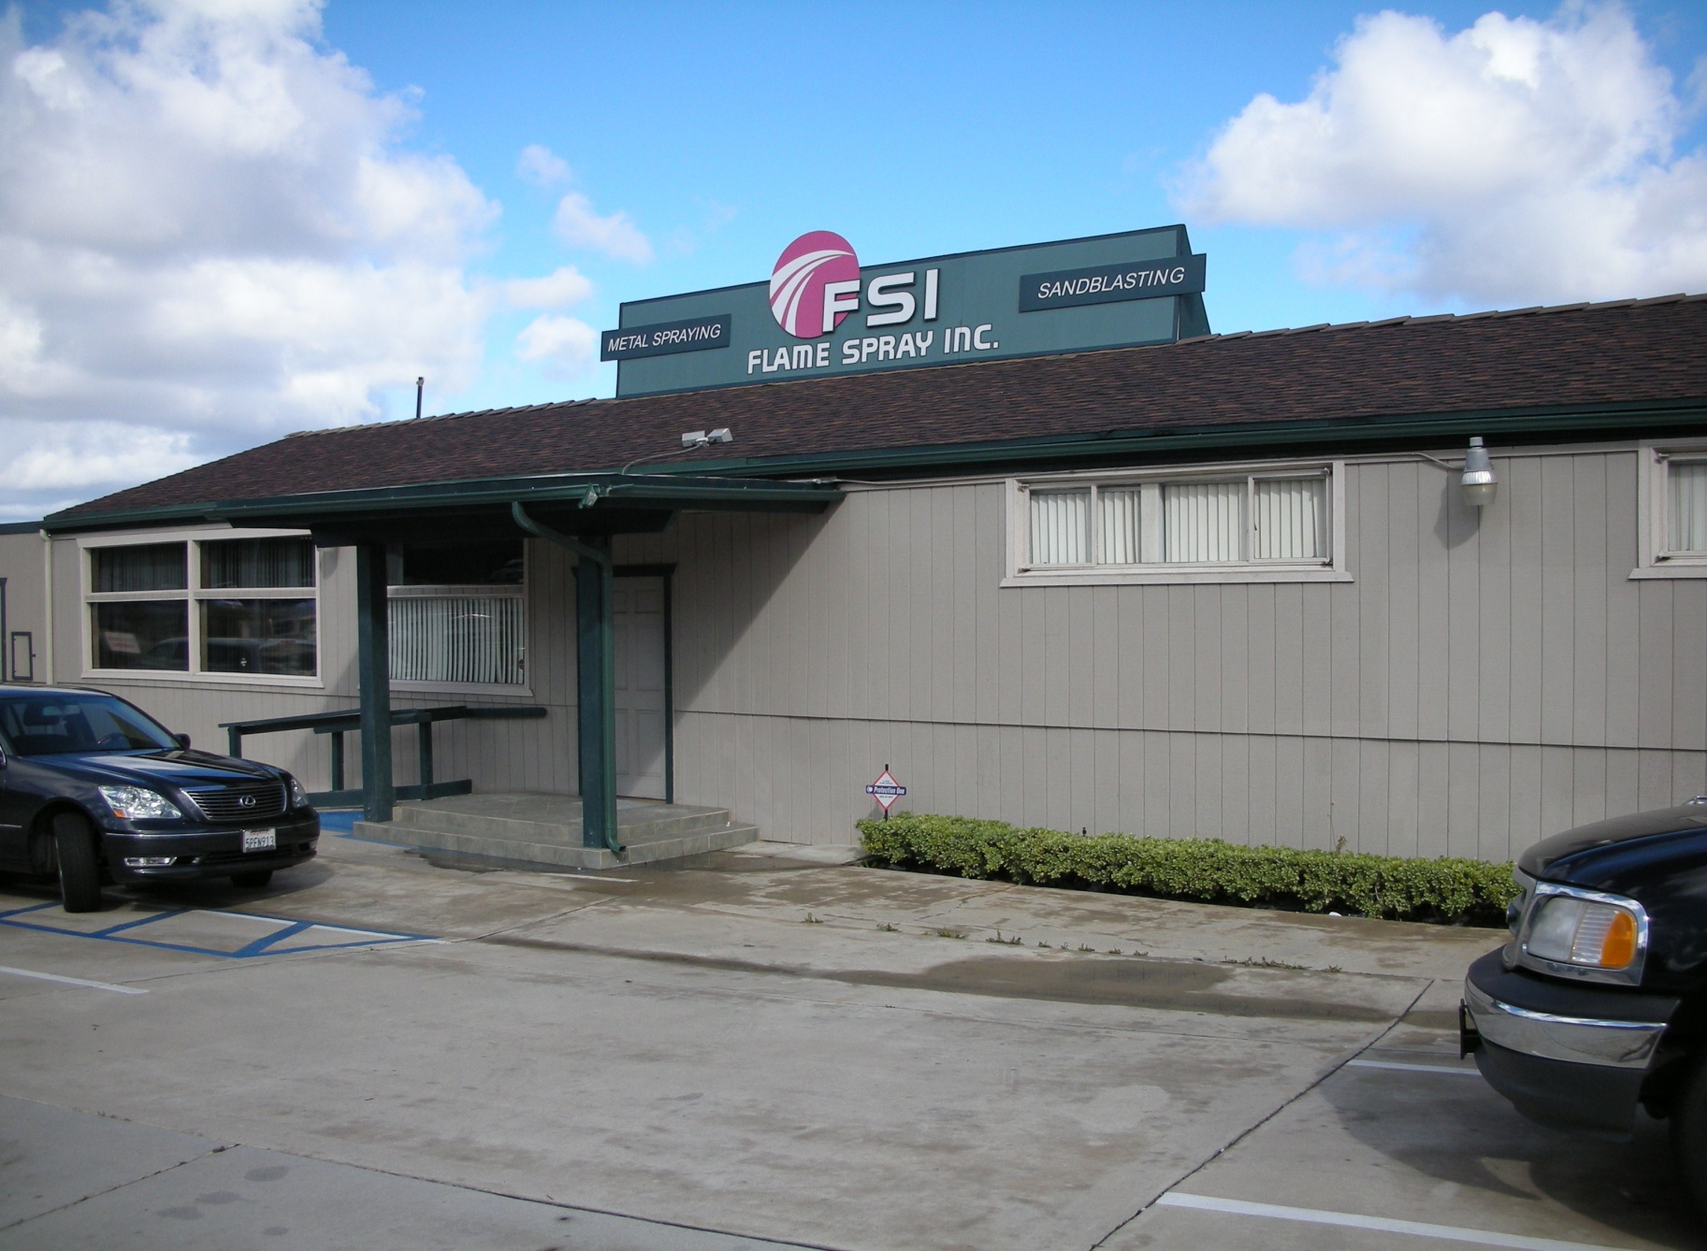
NUCOR
Discussion on
Thermal Barrier Coatings
4647 Alvarado Canyon Road, San Diego, CA 92120
(619) 283-2007
www.flamespraysandiego.com

Slide 2
FSI History Includes
1. Only Full-Service Thermal-Spray shop
in San Diego Area since 1969
2. Aero Space Applications for
- Pratt Whitney Aircraft
- General Electric
- NASA
- Rolls Royce
5

Slide 3

What is Thermal Spraying?
FEEDSTOCK
ATOMIZED & PROPELLED
HEATED
TO FORM LAMINAR TSC
ON PREPARED SUBSTRATE
Thermal Spraying is the process of heating, atomizing & propelling vaporized materials to a prepared substrate.

Slide 4
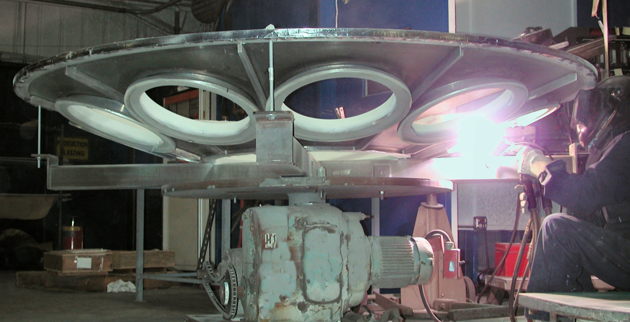
Thermal Barrier Coating (TBC) for
NASA Rocket Launcher Fuel Tank
Notes:
<number>

Slide 5
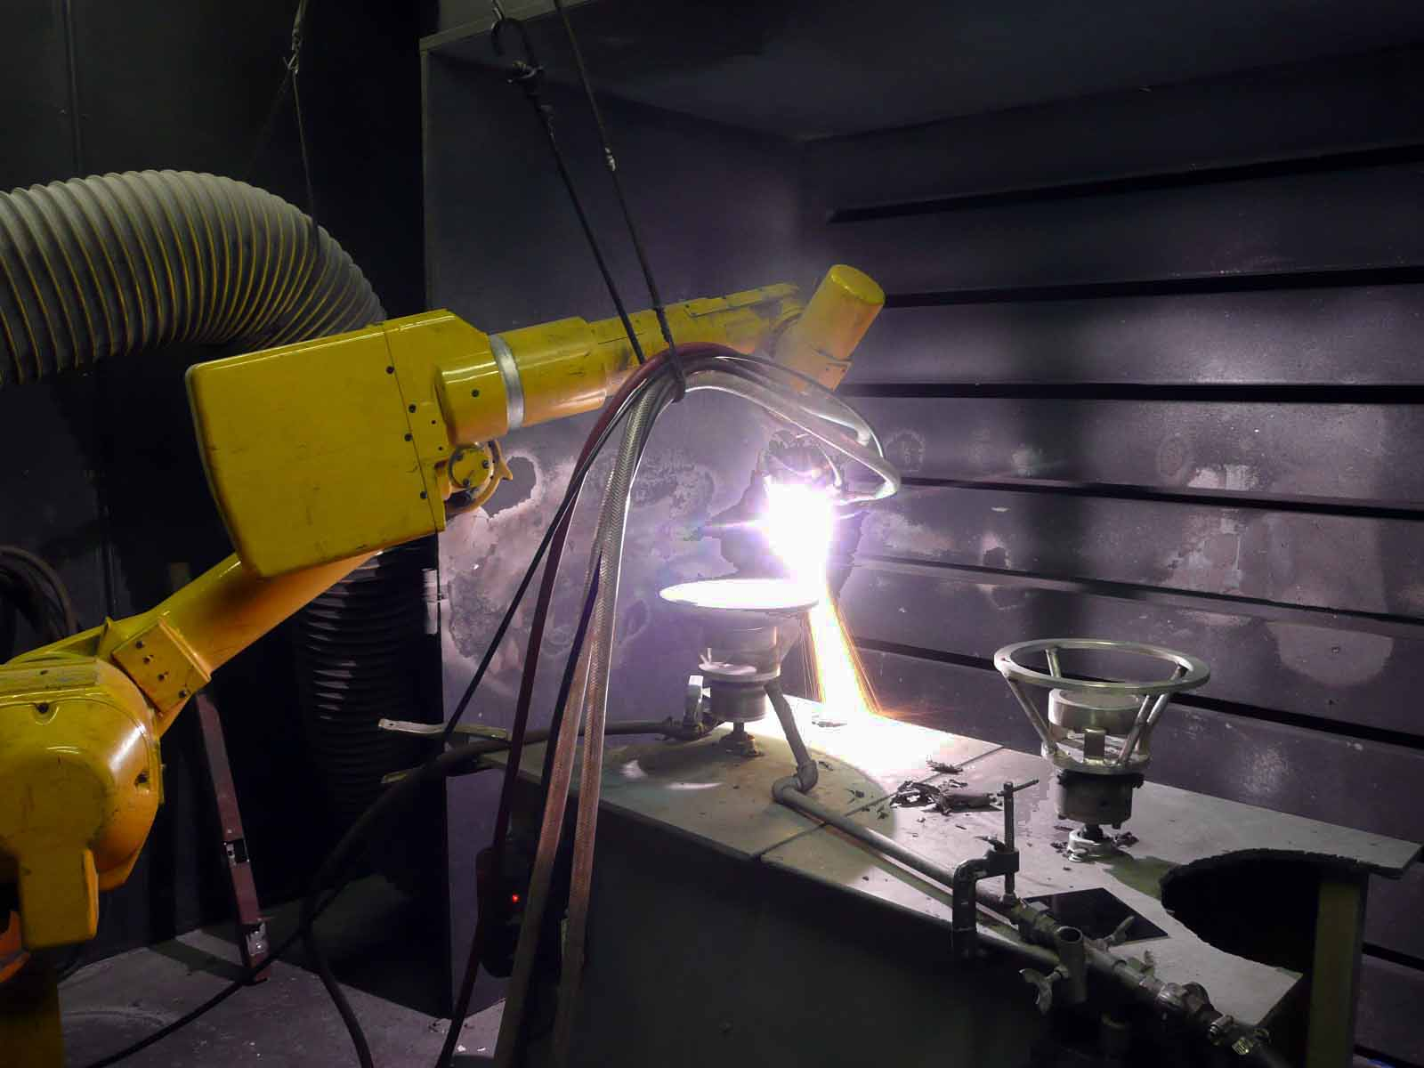
Missile Slew Cones
Notes:
<number>

Slide 6

V-22 Osprey lifting USMC Hummer. High engine exhaust heat softens organic non-skid coatings of ship’s flight deck.
Notes:
V-22 Osprey lifting USMC Hummer. High engine exhaust heat softens organic non-skid coatings of ship flight deck coatings.
<number>

Slide 7

V-22 Osprey landing on Ship’s Flight Deck
TBC underneath the Organic Non-skid Coating
Notes:
<number>

Slide 8
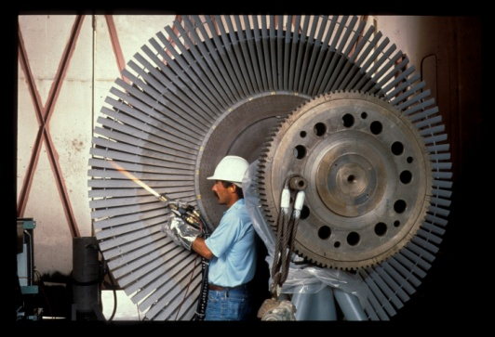
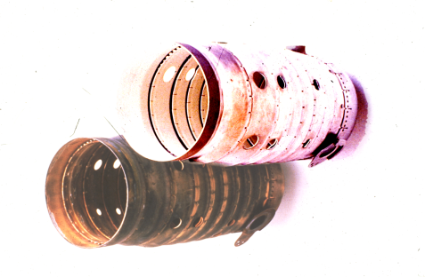
TBCs uses include
Power Plants
Turbine Blades
Burner cans for jet engines
Engine blades on jet engines
Rocket engines.
Notes:
<number>

Slide 9
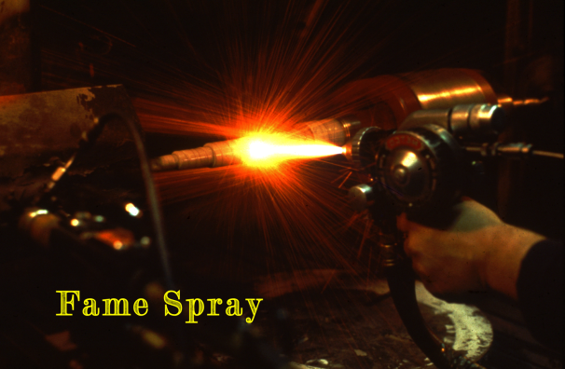
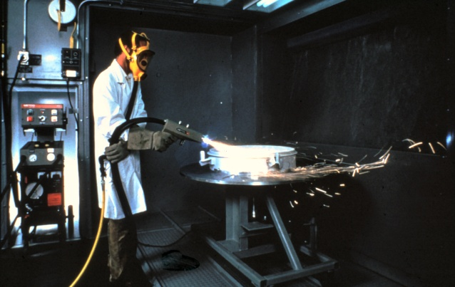
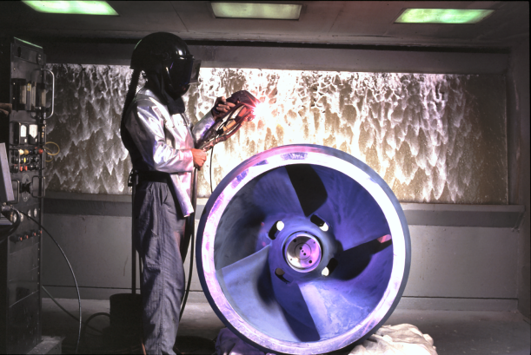
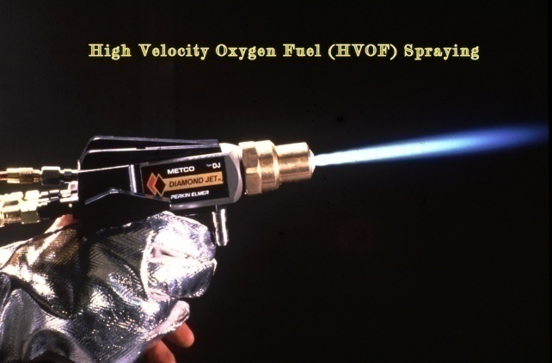
Thermal-Spray Methods
Flame Spray
Arc Spray
Plasma Spray
HVOF Spray

Slide 10
Definitions & Usage of Thermal Spraying
Thermal Spraying is a surface characteristics modification characteristics.
Thermal Spraying is a process of depositing metals, alloys, ceramics & cermets coatings on a properly prepared substrate so that they solidify and bond to it.
TBCs reduce heat transfer to the substrate.

Slide 11
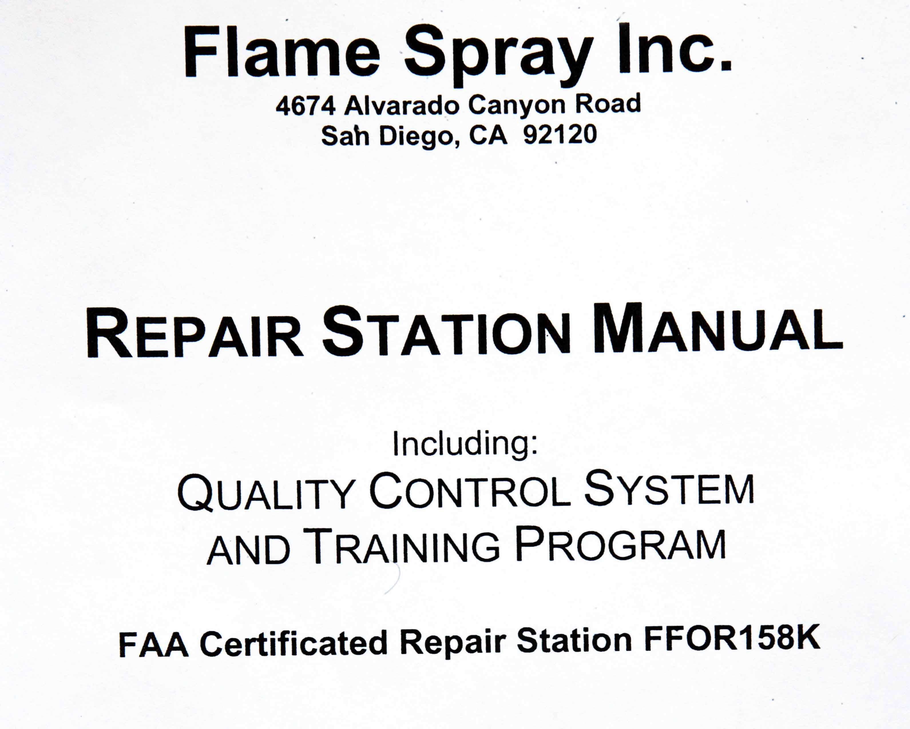
FSI Repair Station Manual including QC Systems & Training Program

Slide 12
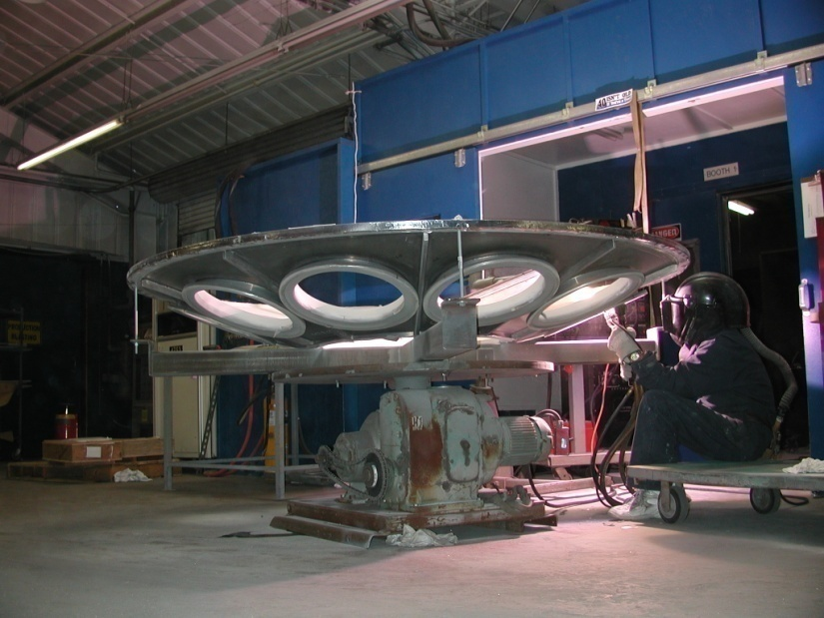
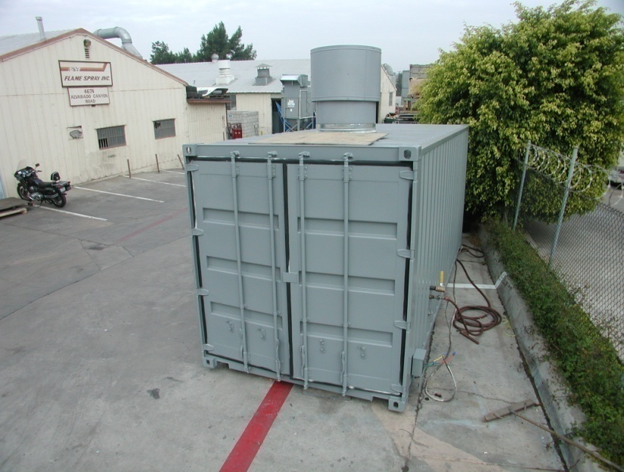
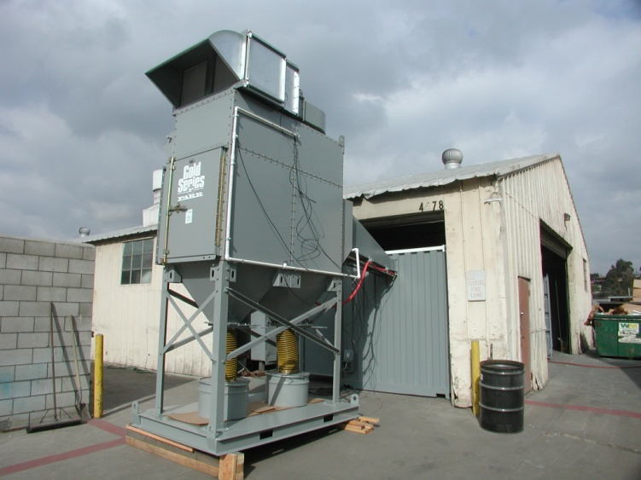
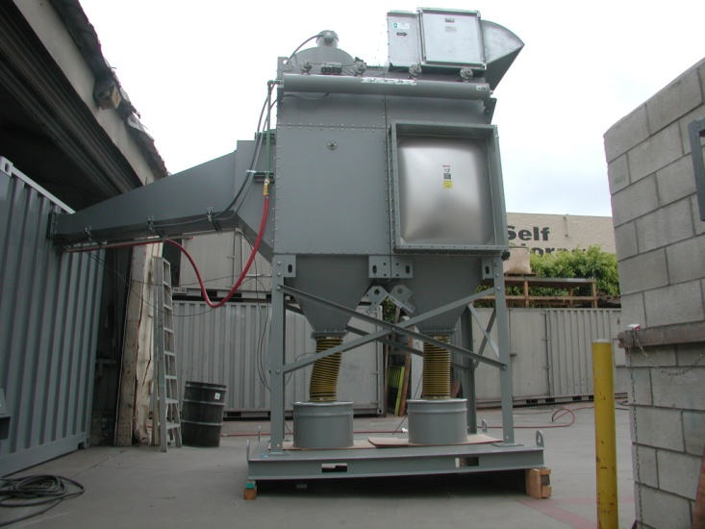
FSI Facilities
20,000 ft dedicated to Flame-Spray applications

Slide 13
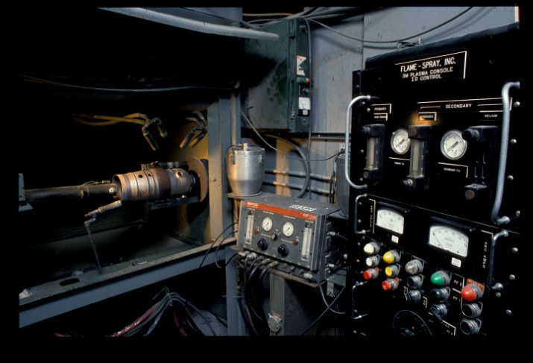
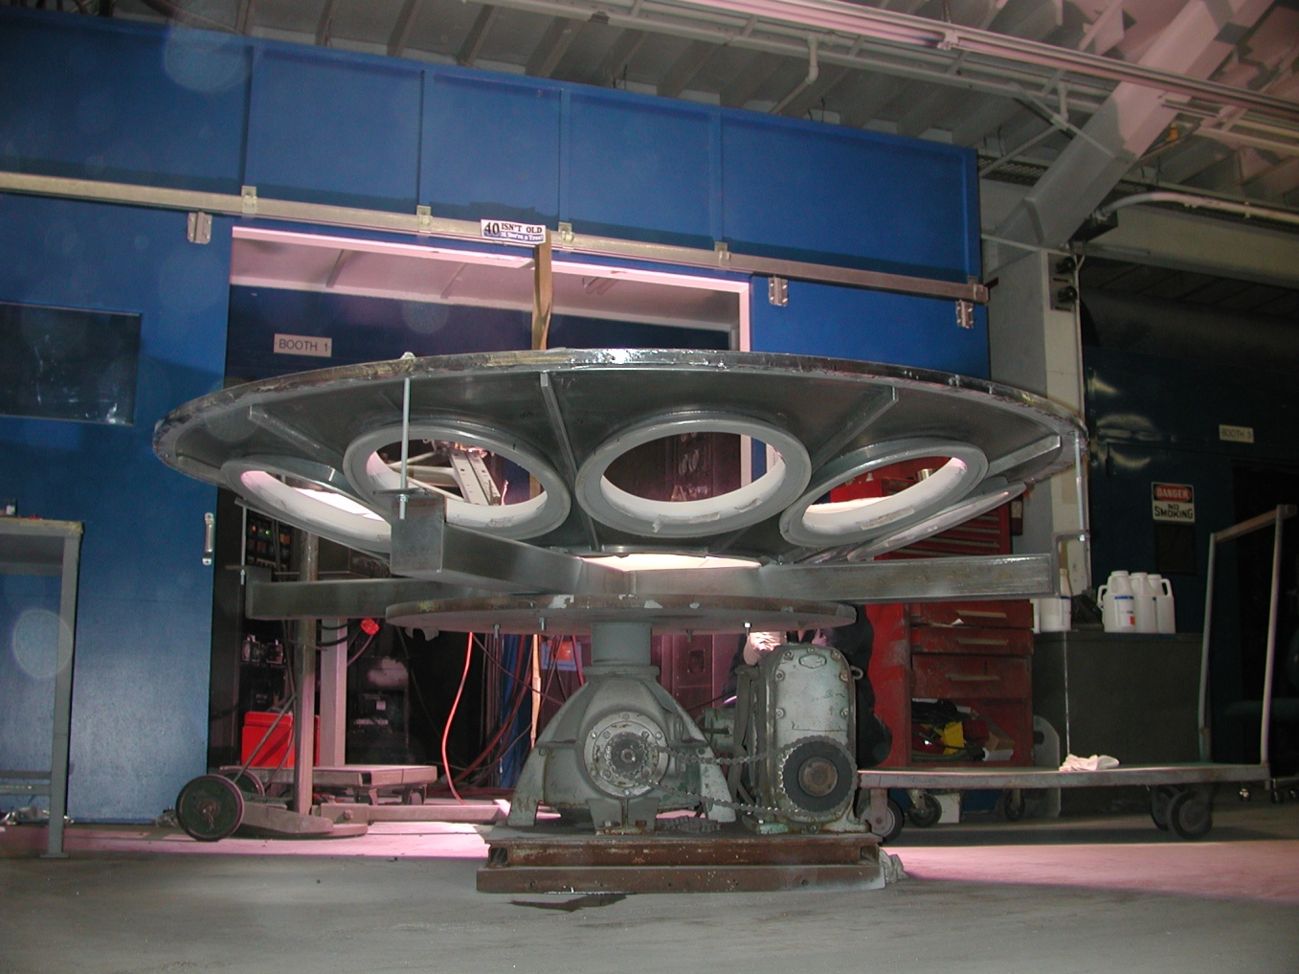
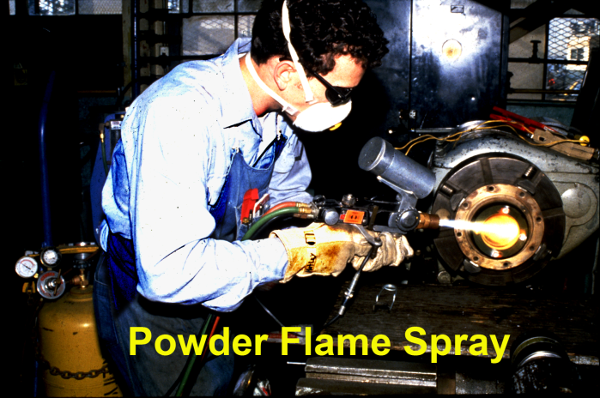
FSI Facilities
10 TS booths (largest 40-ft wide)

Slide 14
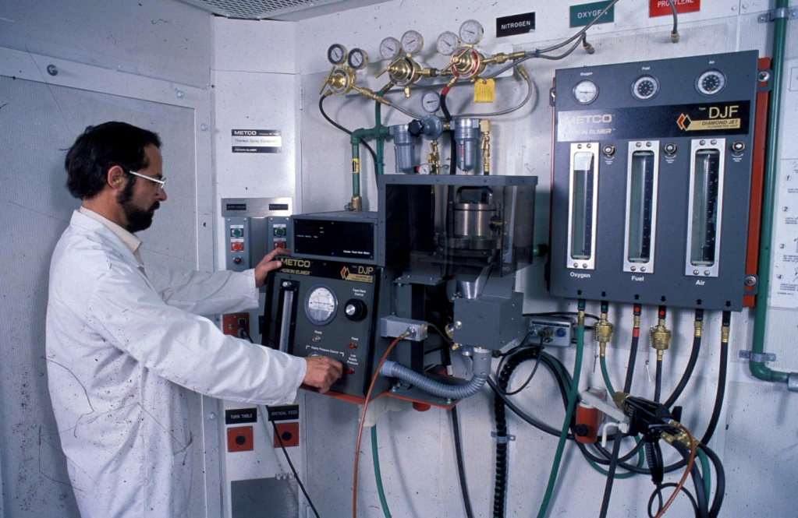
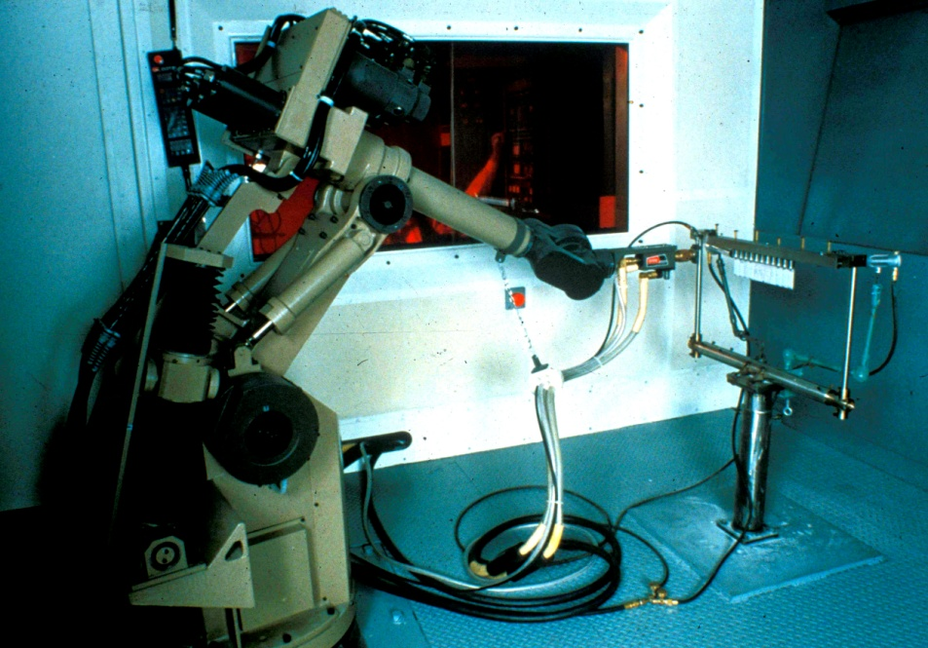
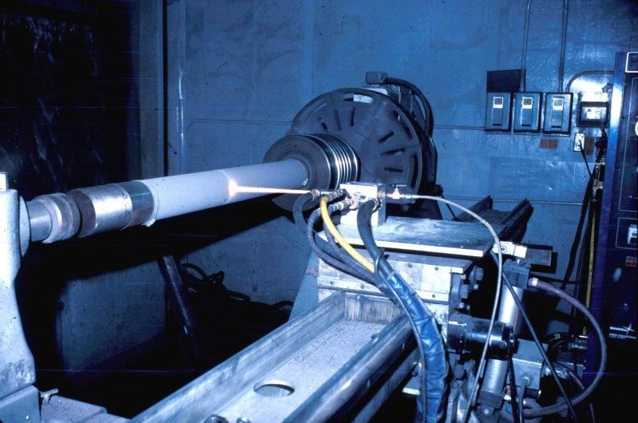
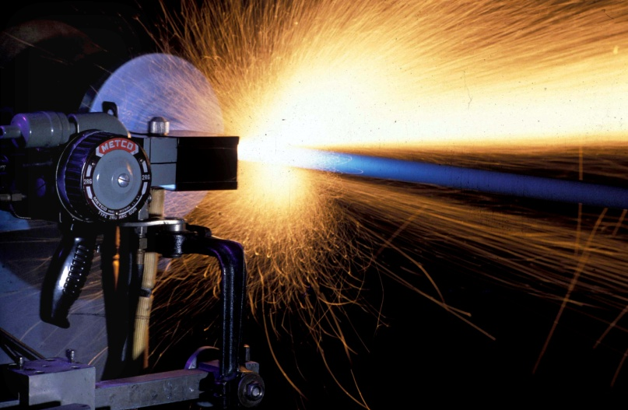
FSI Facilities
4 Robotic Cells

Slide 15
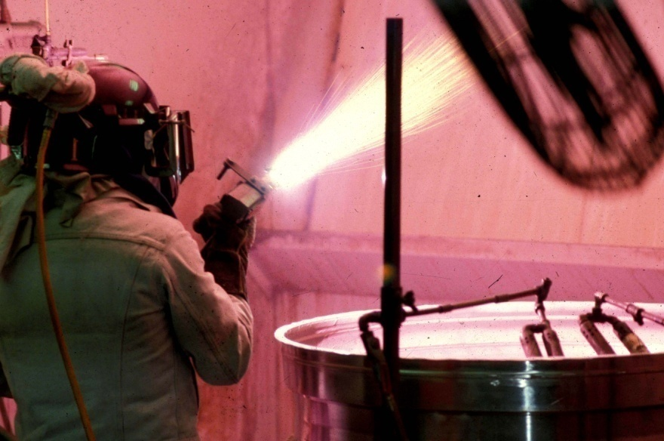
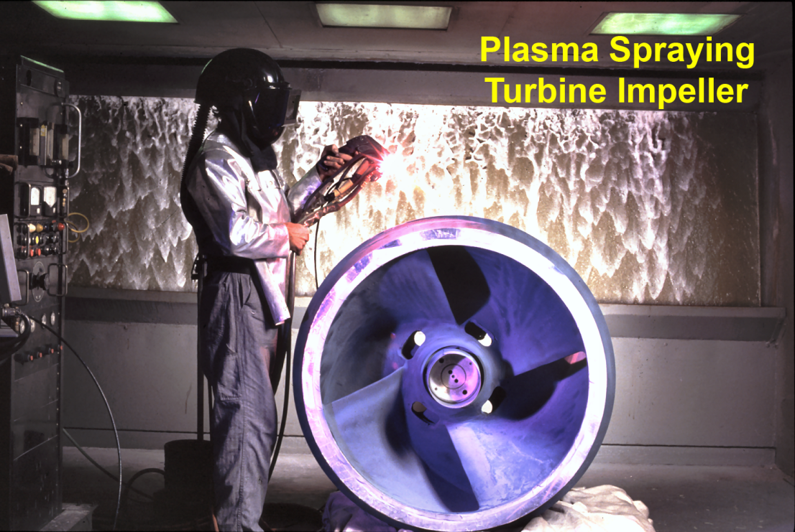

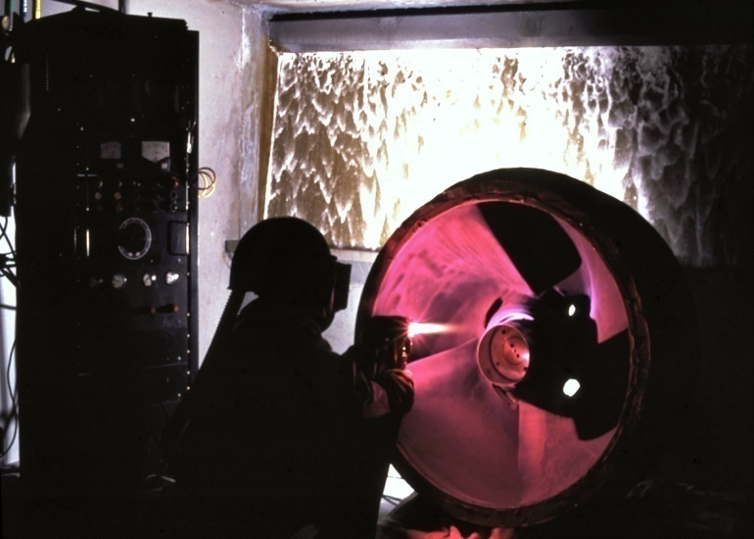
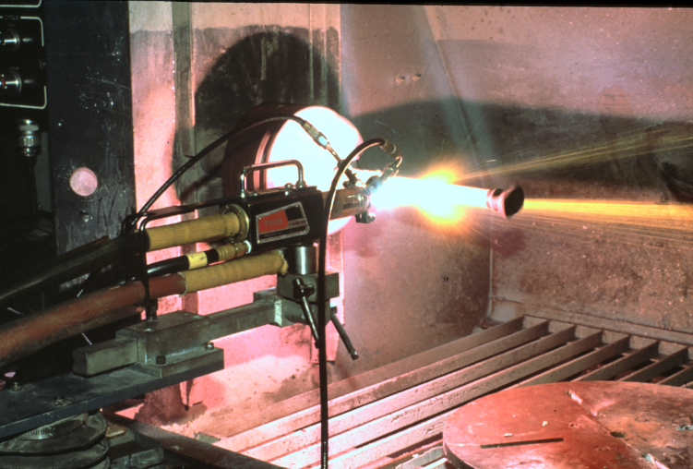
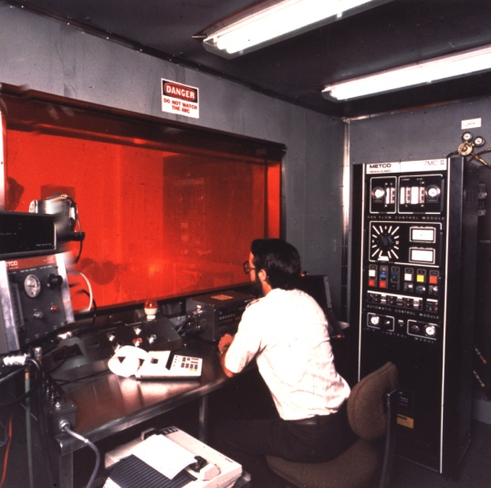
FSI Facilities
9 Plasma Systems

Slide 16
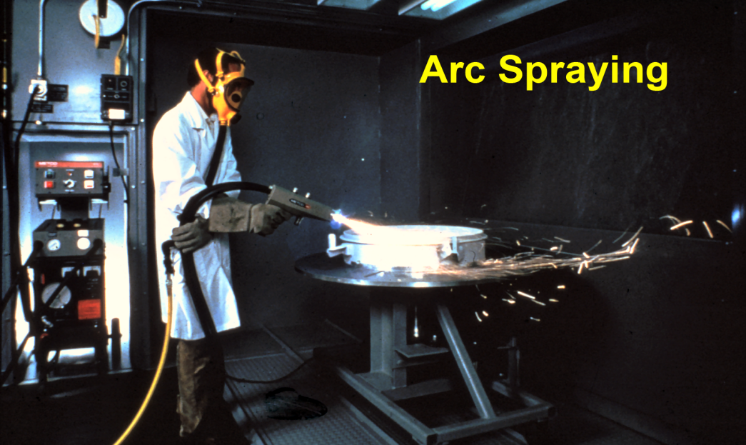
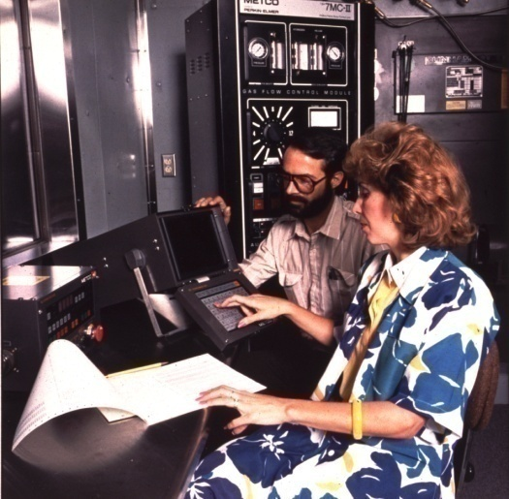
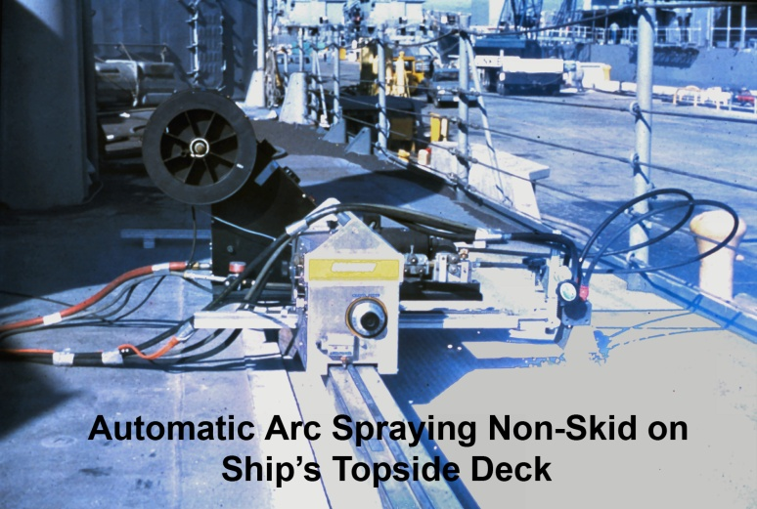
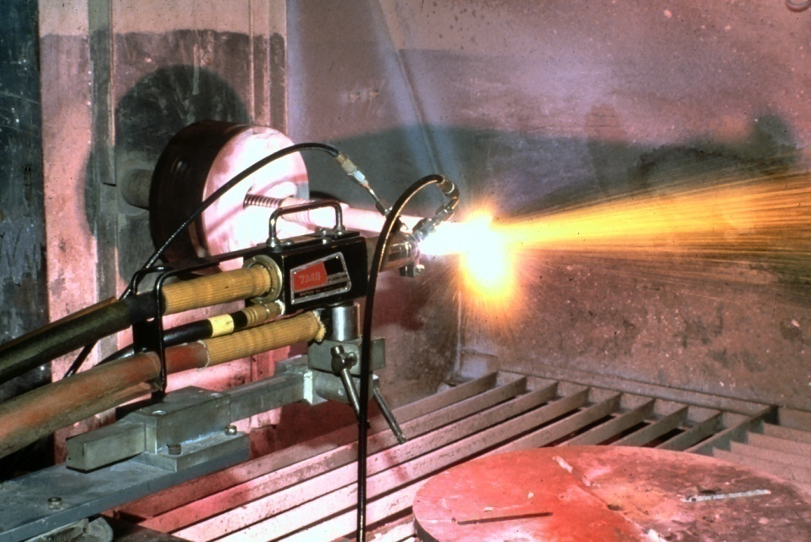
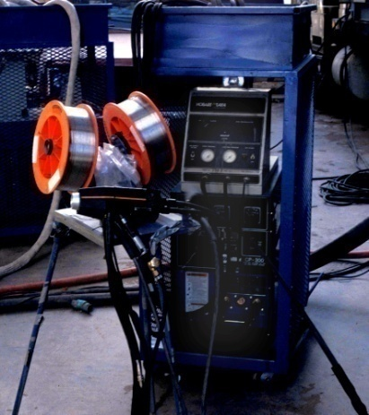
FSI Facilities
Arc Spraying
HVOF Spraying
HVOF, 14 Arc Wire, 4 Combustion Powder

Slide 17
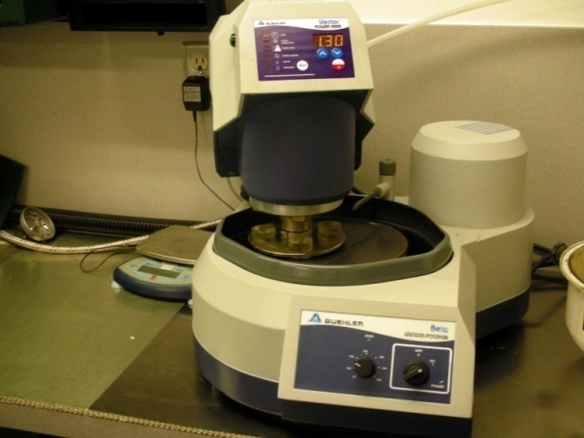
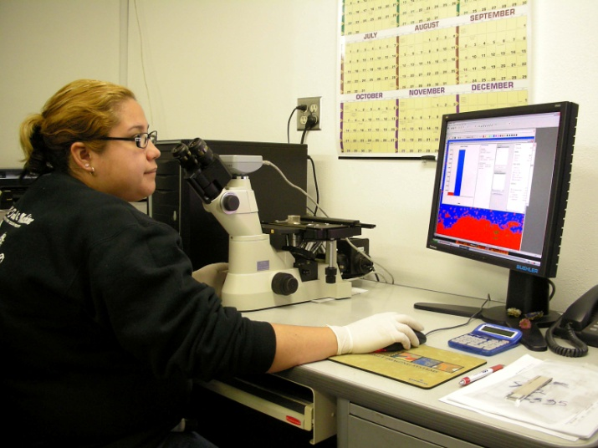
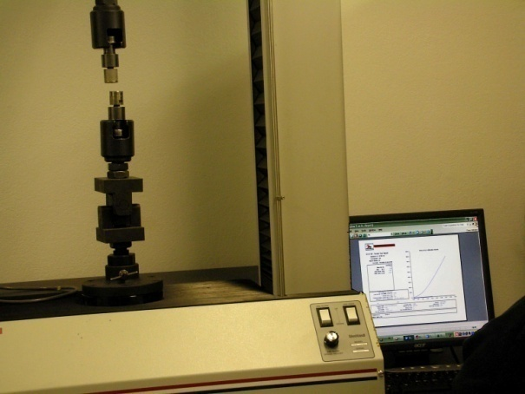
FSI Metallurgical Laboratory
Metallographic Sample
Preparation
Metallurgical
Analysis
Tensile Strength
Measurement
14

Slide 18
What FSI Can Do for NUCOR ?
1 - Qualitatively & Quantitatively discuss the benefits for specific TSC applications.
2 - Schedule and Turn-Around Time.

Slide 19
Flame Spray Inc.
Meeting with NUCOR
Thermal Barrier Coatings
Nov. 20, 2013

Slide 21
NUCOR Electric Arc Furnace

Slide 22
NUCOR Electric Arc Furnace

Slide 23
Schematics of
Electric Arc Furnace

Slide 24
Assembly Detail of
Electric Arc Furnace

Slide 25
Nucor Furnace
with Insulating Brick

Slide 26
NUCOR Furnace Picture

Slide 27
NUCOR Furnace Details

Slide 28
NUCOR Furnace Layout

Slide 29
NUCOR Area of Interest

Slide 30
Thermal Spray Thermal Barrier Coating Uses

Slide 31
Aero-Engine Temperature Trends
GE90-115B
Gas Temperature, FRT
GE90-94B
CFM56-5C4
GE90-90B
Trent 892
CFM56-5B
PW 4090
Trent 556
CFM56-5C2
Trent 772
V2533
CF34-10
CFM56-7B
CFM56-3C
BR 715
PW 6024
CF6-50E
CF6-50E2
PW 2037
CF6-80E1
CF6-80C2A5
PW 4062
CF34-8C1
CF6-80A3
CF6-80C2D1F
BR 710
CFM56-2B
CFM56-5A
JT9D
CF6-80C2B1F
CF34-3B
CF34-3A
TF33
CFM56-3B2
CF6-80C2A1
CFM56-3B1
JT8D-219
RB 211
62
64
66
68
70
72
74
76
78
80
82
84
86
88
90
92
94
96
98
00
02
04
06
08
10
12
Engine Certification Date

Slide 32
Higher Firing Temperatures Needed to Improve Fuel Efficiency
Ideal temperature is around 36000F (20000C)
but materials melt or lack structural strength
Current achieved temperatures are about 26000F (14260C)
Notes:
Fuel efficiency improves as firing temperatures increase
This is because at the ideal temperature of 2000 C all the fuel is burned up in the combustion process
But most materials cannot survive above 1100 or 1200 C

Slide 33
TBC Coatings in Aerospace
Low K Coating
Ceramic YSZ
Bond coat
MCrAlY
Bond Coat / Superalloy
Substrate
cooling
Notes:
To combat this condition Thermal Barrier Coatings are utilized

Slide 34
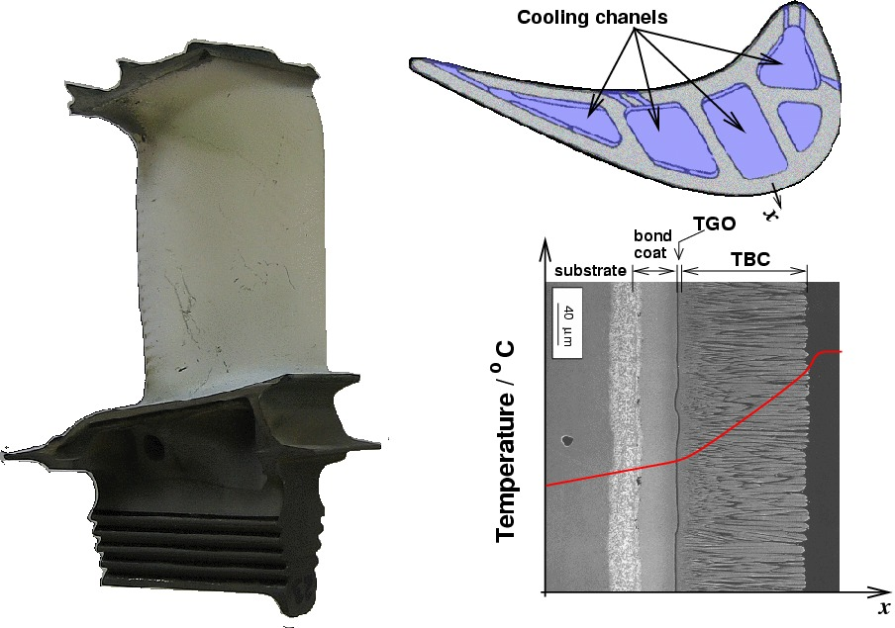
TBC Coatings in Aerospace
(Image Rolls-Royce Plc) and schematic Profile temperature, note the drop oftemperature close to the blade surface due to the presence of a thin cooling air film.

Slide 35
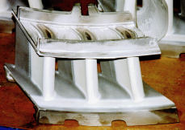
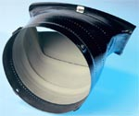
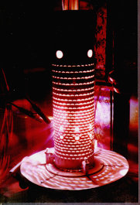
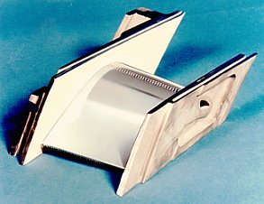
Various Components
Utilizing TBC
Applied to combustion parts
as well as Blades and Vanes

Slide 36
Thermal Spray TBC Examples
Process
Air Plasma Sprayed
EB-PVD
Vacuum Plasma Sprayed
Suspension Plasma Sprayed
Structure
Porous
Dense with vertical cracks
Columnar

Slide 37
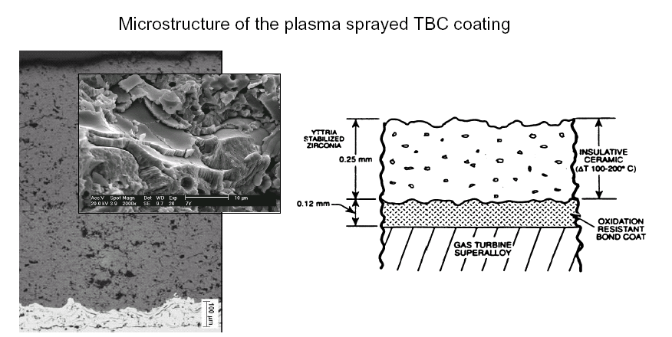
Plasma Spray
-Traditional -
TBC application
Microstructure of Plasma Sprayed TBC Coatings
splats from liquid phase deposition

Slide 38
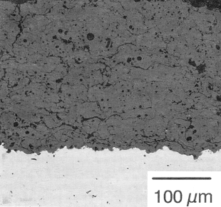
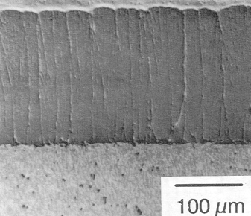
Microstructures of
TS and PVD TBCs
Traditional plasma sprayed YSZ/MCrAlX TBC
Current state-of-the-art EB/PVD YSZ/MCrAlX TBC
Porous and microcracked ceramic layer over a relatively dense metallic bond coat.
Columnar ceramic over a relatively dense bond coat.
Notes:
NO PRINT

Slide 39
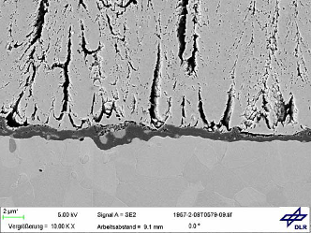
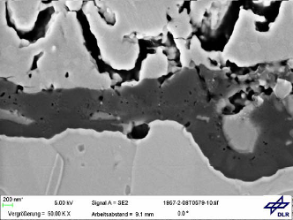
Plasma Spray-PVD
TBC application
Structure and TGO (Thermally Grown Oxide)
Surface
X-section
TBC MCrAlY interface
Close up TGO

Slide 40
Requirement for Thermal Spray Thermal Barrier Coatings
Strain tolerant
Resist thermal shock
High melting and sintering point
Low thermal conductivity
Erosion Resistant
Robust (last long time)
Thin and light weight (for Aero parts)

Slide 41
Building on the Past & Confronting Challenges
Studies have shown that sintering of TBC topcoat is a key property which influences coating life
As a result of sintering the modulus of the coating increases (increased stiffness)
Increase in thermal conductivity is related to sintering of TBC topcoat
Sintering is more pronounced as temperatures increase
Coating typically sinters significantly at the initial stages of engine operation and then levels off

Slide 42
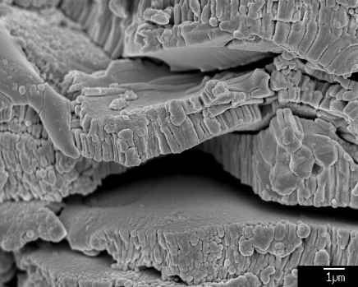
Typical Microstructure
of As-Sprayed TBC YSZ Top Coat
Interlamellar
Pores
Globular pores
Cracks

Slide 43
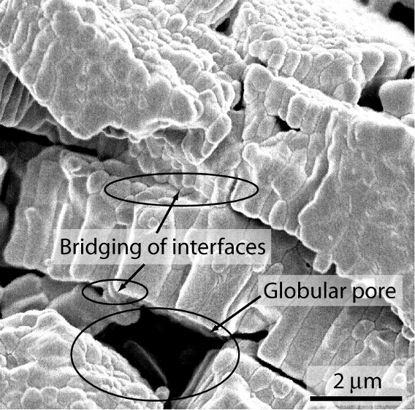
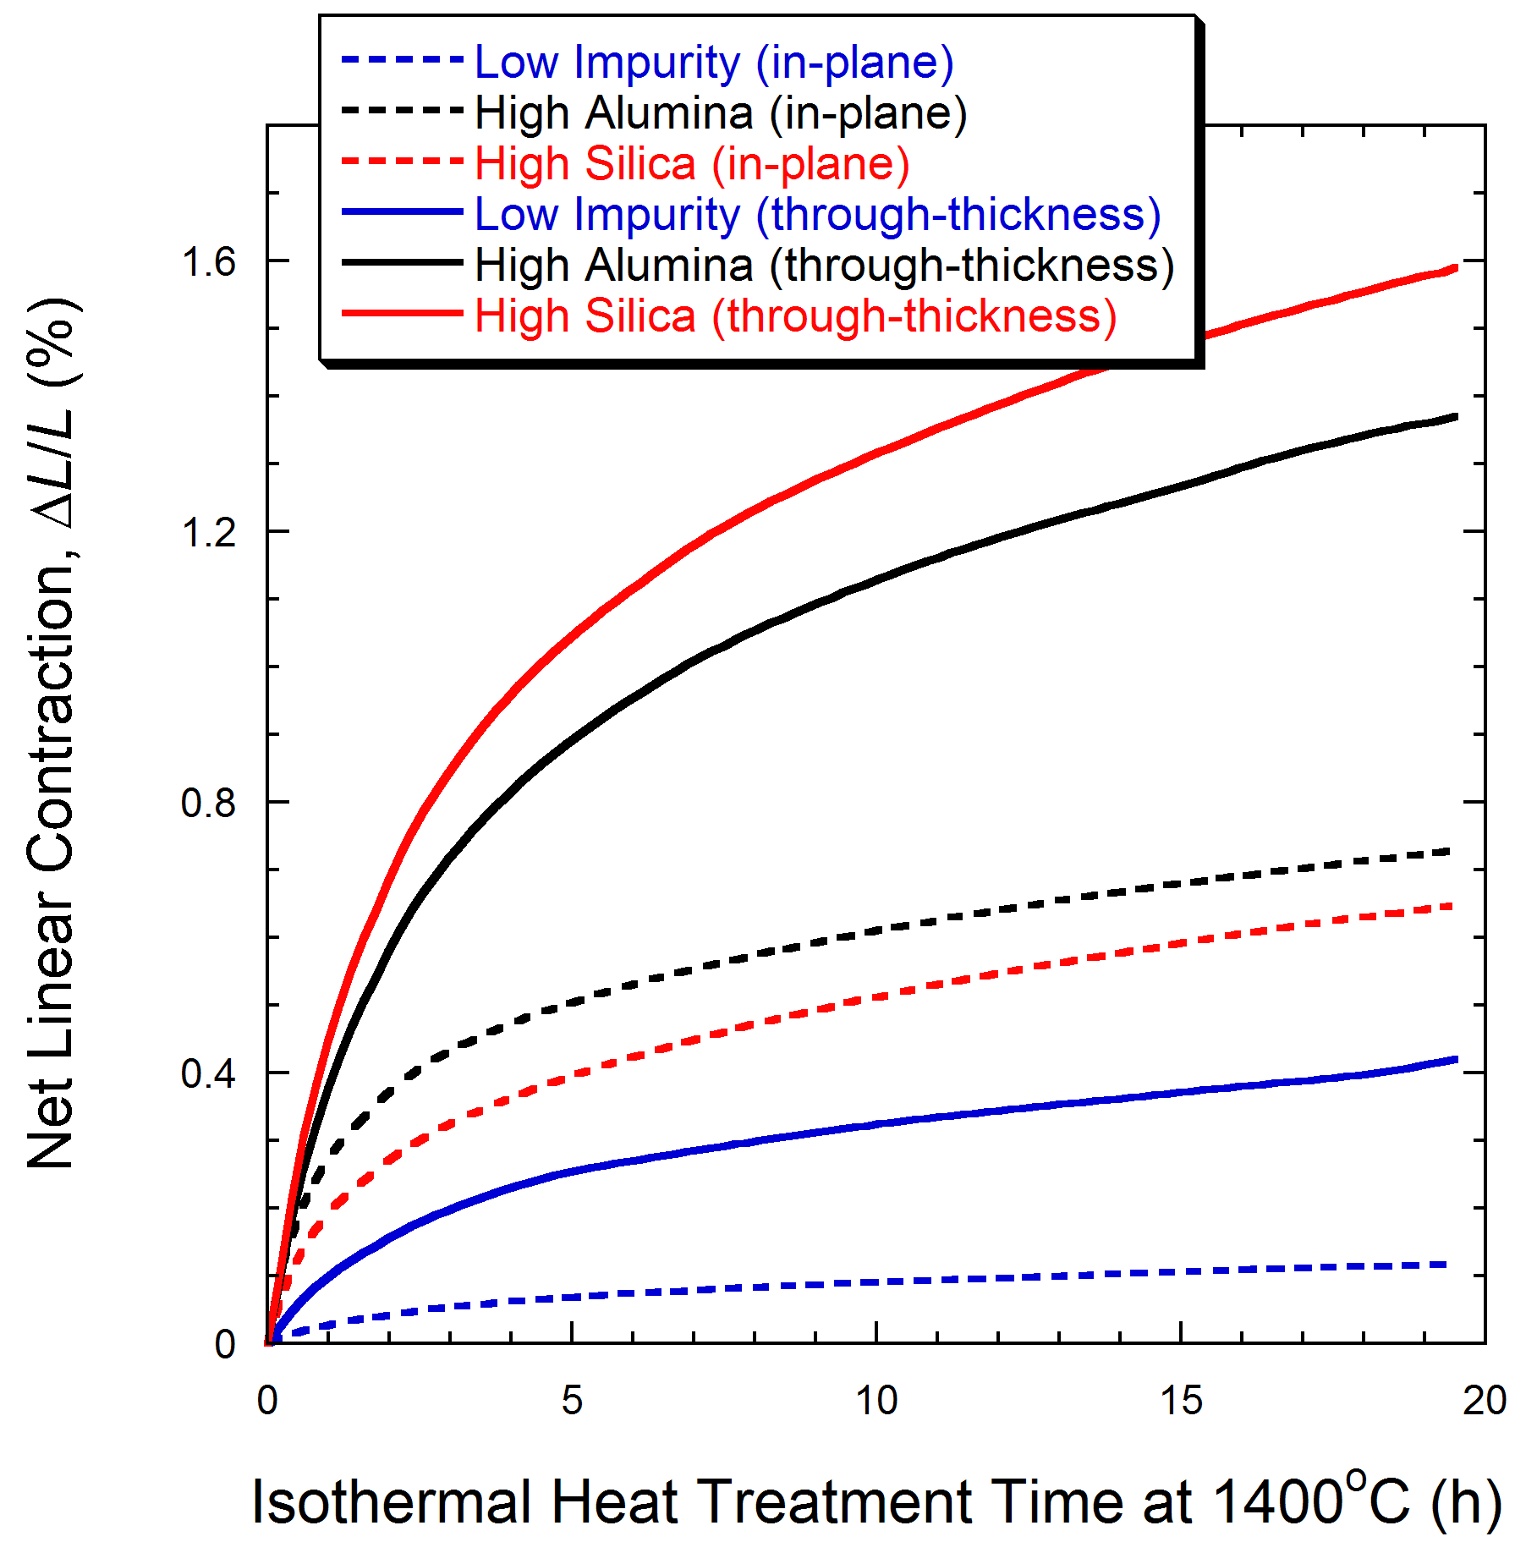
Potential Advanced TBC Systems
High Purity

Slide 44
TBC Ceramics Will See Higher Temperatue Gradients
Need for improved bond coat systems
Need for new TBC chemistries
Need for high purity materials
Need for alternative coating microstructures
Need for reliable and robust processes
Better understanding of testing and characterization

Slide 45
FURNACE REFRACTORIES

Slide 46
Examples of
Refractory Brick Use

Slide 47
Refractory Selection
Requirements of Proper Refractory Selection
Ability to withstand high temperatures and trap heat within limited area of furnace;
Ability to withstand molten metal, hot gasses and slag erosion etc;
Ability to withstand load at service conditions;
Ability to maintain sufficient dimensional stability at high temperatures and after/during repeated thermal cycling;
Ability to conserve heat.

Slide 48
Refractories
Refractories are heat resistant materials used in almost all processes involving high temperatures and/or corrosive environment.
These are typically used to insulate and protect industrial furnaces and vessels due to their excellent resistance to heat, chemical attack and mechanical damage.
Any failure of refractory could result in a great loss of production time, equipment, and sometimes the product itself. The various types of refractories also influence the safe operation, energy consumption and product quality; therefore, obtaining refractories best suited to each application is of supreme importance.
Notes:
<number>

Slide 49
Refractory Use
Refractories are used by the metallurgy industry in the internal linings of furnaces, kilns, reactors and other vessels for holding and transporting metal and slag.
In non-metallurgical industries, the refractories are mostly installed on fired heaters, hydrogen reformers, ammonia primary and secondary reformers, cracking furnaces, incinerators, utility boilers, catalytic cracking units, coke calciner, sulfur furnaces, air heaters, ducting, stacks, etc. Majority of these listed equipment operate under high pressure, and operating temperature can vary from very low to very high (approximately 900°F to 2900°F). The refractory materials are therefore needed to withstand temperatures over and above these temperatures. Listed below is the sample melting temperatures of key metallurgical elements where refractory application is critical.

Slide 50
Properties of Refractories
Important properties of refractories are:
chemical composition
bulk density
apparent porosity
apparent specific gravity
strength at atmospheric temperatures.
These properties are often among those which are used as ‘control points’ in the manufacturing and quality control process.
The chemical composition serves as a basic for classification of refractories and the density, porosity and strength is influenced by many other factors. Among these are type and quality of the raw materials, the size and fit of the particles, moisture content at the time of pressing, pressure at mould, temperature, duration of firing and the rate of cooling.

Slide 51
Refractory Materials

Slide 52
Porosity
Porosity is a measure of the effective open pore space in the refractory into which the molten metal, slag, fluxes, vapors etc can penetrate and thereby contribute to eventual degradation of the structure. The porosity of refractory is expressed as the average percentage of open pore space in the overall refractory volume.
High porosity materials tend to be highly insulating as a result of high volume of air they trap, because air is a very poor thermal conductor. As a result, low porosity materials are generally used in hotter zones, while the more porous materials are usually used for thermal backup.
Such materials, however, do not work with higher temperatures and direct flame impingement, and are likely to shrink when subjected to such conditions. Refractory materials with high porosity are usually NOT chosen when they will be in contact with molten slag because they cannot be penetrated as easily.

Slide 53
Thermal Conductivity
Thermal conductivity is defined as the quantity of heat that will flow through a unit area in direction normal to the surface area in a defined time with a known temperature gradient under steady state conditions. It indicates general heat flow characteristics of the refractory and depends upon the chemical and compositions as well as the application temperature.
High thermal conductivity refractories are required for some applications where good heat transfer is essential such as coke oven walls, regenerators, muffles and water cooled furnace walls. However, refractories with lower thermal conductivity are preferred in industrial applications, as they help in conserving heat energy.
Porosity is a significant factor in heat flow through refractories. The thermal conductivity of a refractory decreases on increasing its porosity.
The porosity with affect the thickness of brick work.

Slide 54
Classification of Refractories
Classification Based on Method of Manufacture. The refractories can be manufactured in either of the following methods:
Dry Press Process
Fused Cast
Hand Molded
Formed (Normal, Fired or chemical bonded)
Unformed (Monolithic – Plastics, Ramming mass, Gunning, Cast able, Spraying

Slide 55
Shaped Refractories
Shaped refractories have fixed shape - bricks. Brick shapes maybe divided into two: standard shapes and special shapes. Standards shapes have dimension that are conformed to by most refractory manufacturers and are generally applicable to kilns and furnaces of the same type. Special shapes are specifically made for particular kilns and furnaces.
Shaped refractories, are machine-pressed, with high uniformity in properties. Special shapes are most often hand-molded and are expected to exhibit slight variations in properties.

Slide 56
Types of Refractories
Refractories are classified as dense or insulating types. The most high-temperature refractories, such as firebricks, are high-density (>120 lb/ft3).
They offer excellent resistance to environments such as slags with different chemical compositions, fumes, dust, and gases.
Insulating refractories have lower densities (4 to 70 lb/ft3) and provide insulating properties, while offering resistance to corrosion and chemical reactions with the operating environment.

Slide 57
Insulating Refractories
These are high porosity refractories with low thermal conductivity used in order to reduce the rate of heat flow (heat losses) and thus to maximize heat conservation within the furnace. These have lower densities in range of 4 to 70 lb/ft3. The three basic types of insulating materials for industrial use are:
(1) thin (less than 20 micrometers), low-density (less than 12 lb/ft3) fibers made from organic or inorganic materials;
(2) cellular material in closed or open cell form made of organic or inorganic material; and
(3) flaked or granular inorganic materials bonded in the desired form. In most cases, glass (silica), mineral wool, high alumina, mulite, or zirconia are the base materials and can be used to temperatures as high as 2900°F. This class of materials has a lower density that varies from 4 lb/ft3 to 12 lb/ft3 and offers higher thermal resistance compared to firebricks. In all cases, thermal conductivity of the insulation increases significantly as temperature increases.

Slide 58
Insulating Materials
Insulating materials can be classified with respect to application temperature:
1) Heat resistant insulating materials for application temperatures up to 2000°F: calcium silicate materials; products from siliceous earth, perlite or vermiculite; silica based micro porous heat insulators; alumino-silicate fibers;
2) Refractory insulating materials for application temperatures up to 2500°F: lightweight chamotte and kaolin bricks; lightweight castables; mixed fibers and aluminum oxide fibers;
3) High refractory insulating materials for application temperatures up to 3100°F: lightweight mullite and alumina bricks; lightweight hollow sphere corundum castables and bricks; special high refractory fibers;
4) Ultra-high refractory insulating materials for application temperatures up to 3600°F: zirconia lightweight bricks and fibers; non-oxide compounds;
Extremely lightweight materials have a porosity of 75 to 85% and ultra-lightweight, high-temperature insulating materials have a total porosity greater than 85%.

Slide 59
Zirconia Refractories
There are certain difficulties in its usage and fabrication as a refractory material. It is essential to stabilize it before application as a refractory. This is achieved by incorporating small quantities of calcium, magnesium and cerium oxide, etc. Its properties depend mainly on degree of stabilization and quantity of stabilizer as well as the quality of original raw material.
Zirconia refractories have a very high strength at room temperature which is maintained up to temperatures as high as 2700°F. They are useful as high temperature construction materials for furnaces and kilns. The thermal conductivity of zirconium dioxide is found to be much lower than that of most other refractories and the material is therefore used as a high temperature insulating refractory. Since Zirconia exhibits very low thermal losses and does not react readily with liquid metals, it useful for making refractory crucibles and other vessels for metallurgical purposes. Zirconia is useful refractory material for glass furnaces primarily since it is not easily wetted by molten glass and because of its low reaction with them.

Slide 60
Area of Application
Selecting insulation materials and designing insulation systems requires evaluation of four factors: Thermal performance; Physical properties; Chemical characteristics and Costs.
Thermal performance- involves temperature limit; melting or fusion temperature; thermal conductivity (or insulation capability); heat capacity or storage; thermal expansion; and thermal shock (spalling) resistance. Operating temperature is an important criterion for selection of refractories. Temperatures exceeding the refractory’s rating can soften its surface and cause rapid erosion and failure. If the operating conditions heat or cool the refractory lining beyond its specified range, the resulting thermal shock can damage the integrity of the lining.

Slide 61
Design of Furnace/Vessels
Design of furnace/vessels -The performance and stability of the refractory lining depends on the structural design of the furnace and its configuration.
Sometimes adequate attention is not given to the refractory lining and its engineering related issues during early plant equipment design. This may lead to several compromises as there is limited scope for change in vessel design, operating conditions and the process to reduce the impact of these factors on lining performance during later stages of detailed engineering. The refractory lining failure may occur due to insufficient combustion volume. The heat released within the system is generally more than absorbed by the process and is dissipated through walls or exhausted with flue gases. In such cases, there are possibilities of the lining approaching the flame temperature and causing several problems. The burner type, its design, location, flame shape, possibilities of flame impingement, flowing pattern of flue gases, etc., may affect the lining. In many cases, limited vessel dimensions, inaccessibility and complicated configuration restricts the best lining practices during initial construction as well as subsequent maintenance and repair.

Slide 62
Zirconia Refractory Tiles

Slide 63
Conductivity & Heat Losses

